Slide 1
Calc – My First Programmed APP

Slide 2
What are we going to make?
An app which :
  Acts as a simple calculator
  Converts currency when you are on holiday
  Works out the area of some mathematical shapes

Slide 3
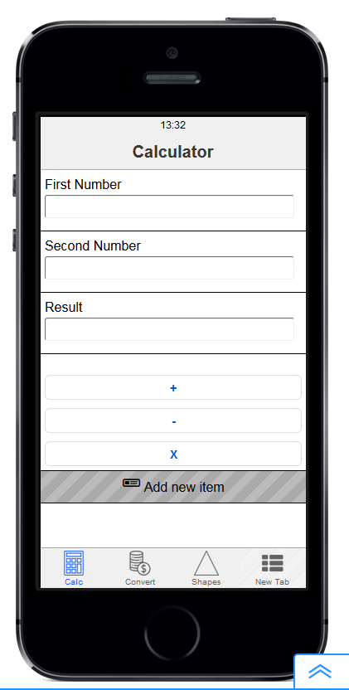
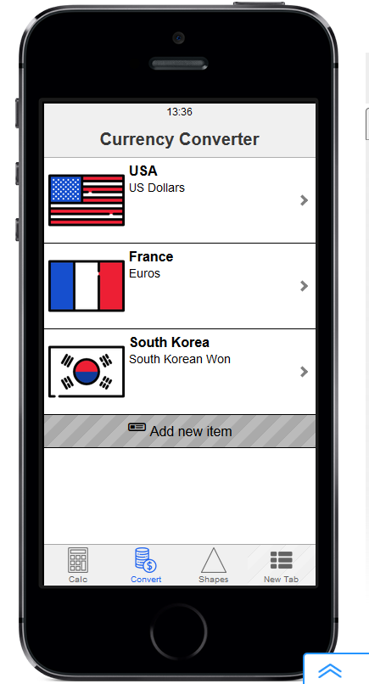

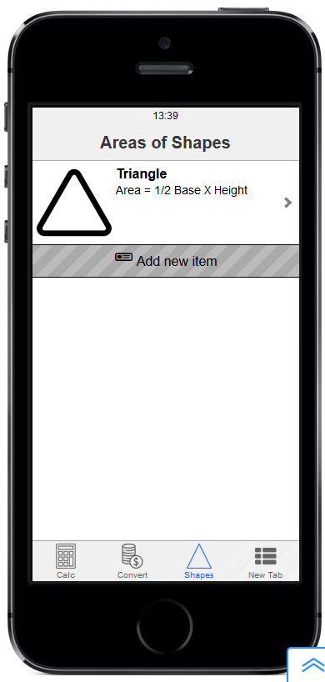
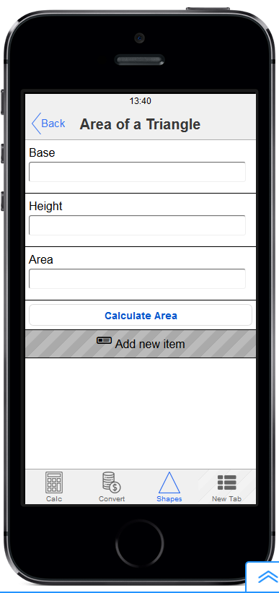
What will our app look like?

Slide 4
Initial assets
  Tab icons for the three main areas : (these must be monocolour)
    calculator
    currency converter
    shapes
  icons of flags for the countries on the currency page (in the same style)
    USA
    France
    one other (perhaps the country you are going holiday to this year)
  icons of three shapes : (similar to each other in style)
    rectangle
    triangle
    circle

Slide 5
Calculator page - contents
an input box whose title is First Number and name is one
a second input box whose title is Second Number and name is two
a third input box whose title is Result and name is result
(note that all names are in lowercase)
Three buttons for
  +
  -
  X

Slide 6
Currency Convert page - contents
Three image links, each with :
  The flag of the country as the image
  Title the name of the country
  Subtitle the name of the currency used in that country
  (Two of these must be the USA and France)

Slide 7
Country Pages (3 of these) - contents
Three input boxes, each with :
  A suitable title to appear on the page
  A suitable name, in lowercase, for programming later
A button showing the word Convert

Slide 8
Shapes page - contents
Three image links, (only one shown here) each with :
  An icon showing the correct shape
  Title the name of the shape
  Subtitle the formulae used to calculate the area

Slide 9
Individual Shape Pages (3 of these) - contents
Three input boxes, for rectangle, triangle and circle, each with :
  A suitable title to appear on the page
  A suitable name, is lowercase, for programming later
A button showing the words Calculate Area

Slide 10
The basic javascript code
var firstnum = eval(app.getVariable("one"))
var secondnum = eval(app.getVariable("two"))
var answer = firstnum + secondnum
app.setVariable("result", answer)

Slide 11
Final tasks – can your Work them out for Yourself?
You should only do these after you are convinced that the rest works
  Add a divide (/) option to the calculator page
  Add a ‘Clear’ button to the calculator page which sets all numbers to 0.
  See next slide for extension work :

Slide 12
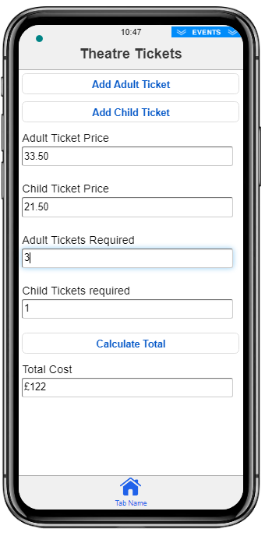
Final Extension
Add a new Tab labelled Tickets
Lay out a ticket purchase screen as shown (the prices of the tickets can just be typed in)
Program the two buttons at the top to add one ticket each time they are pressed
Program the Calculate Total button to work out the cost of all tickets
(An example of it working correctly is shown)

Slide 13
Calc – a timeline
Lesson 1
Initial Design
Setting up structure of App
Lesson 2
Learning how to program
Programming Calculator page
Creating and programming other pages
Lesson 3
Complete App
Do Extension if time
Testing

